Slide 1
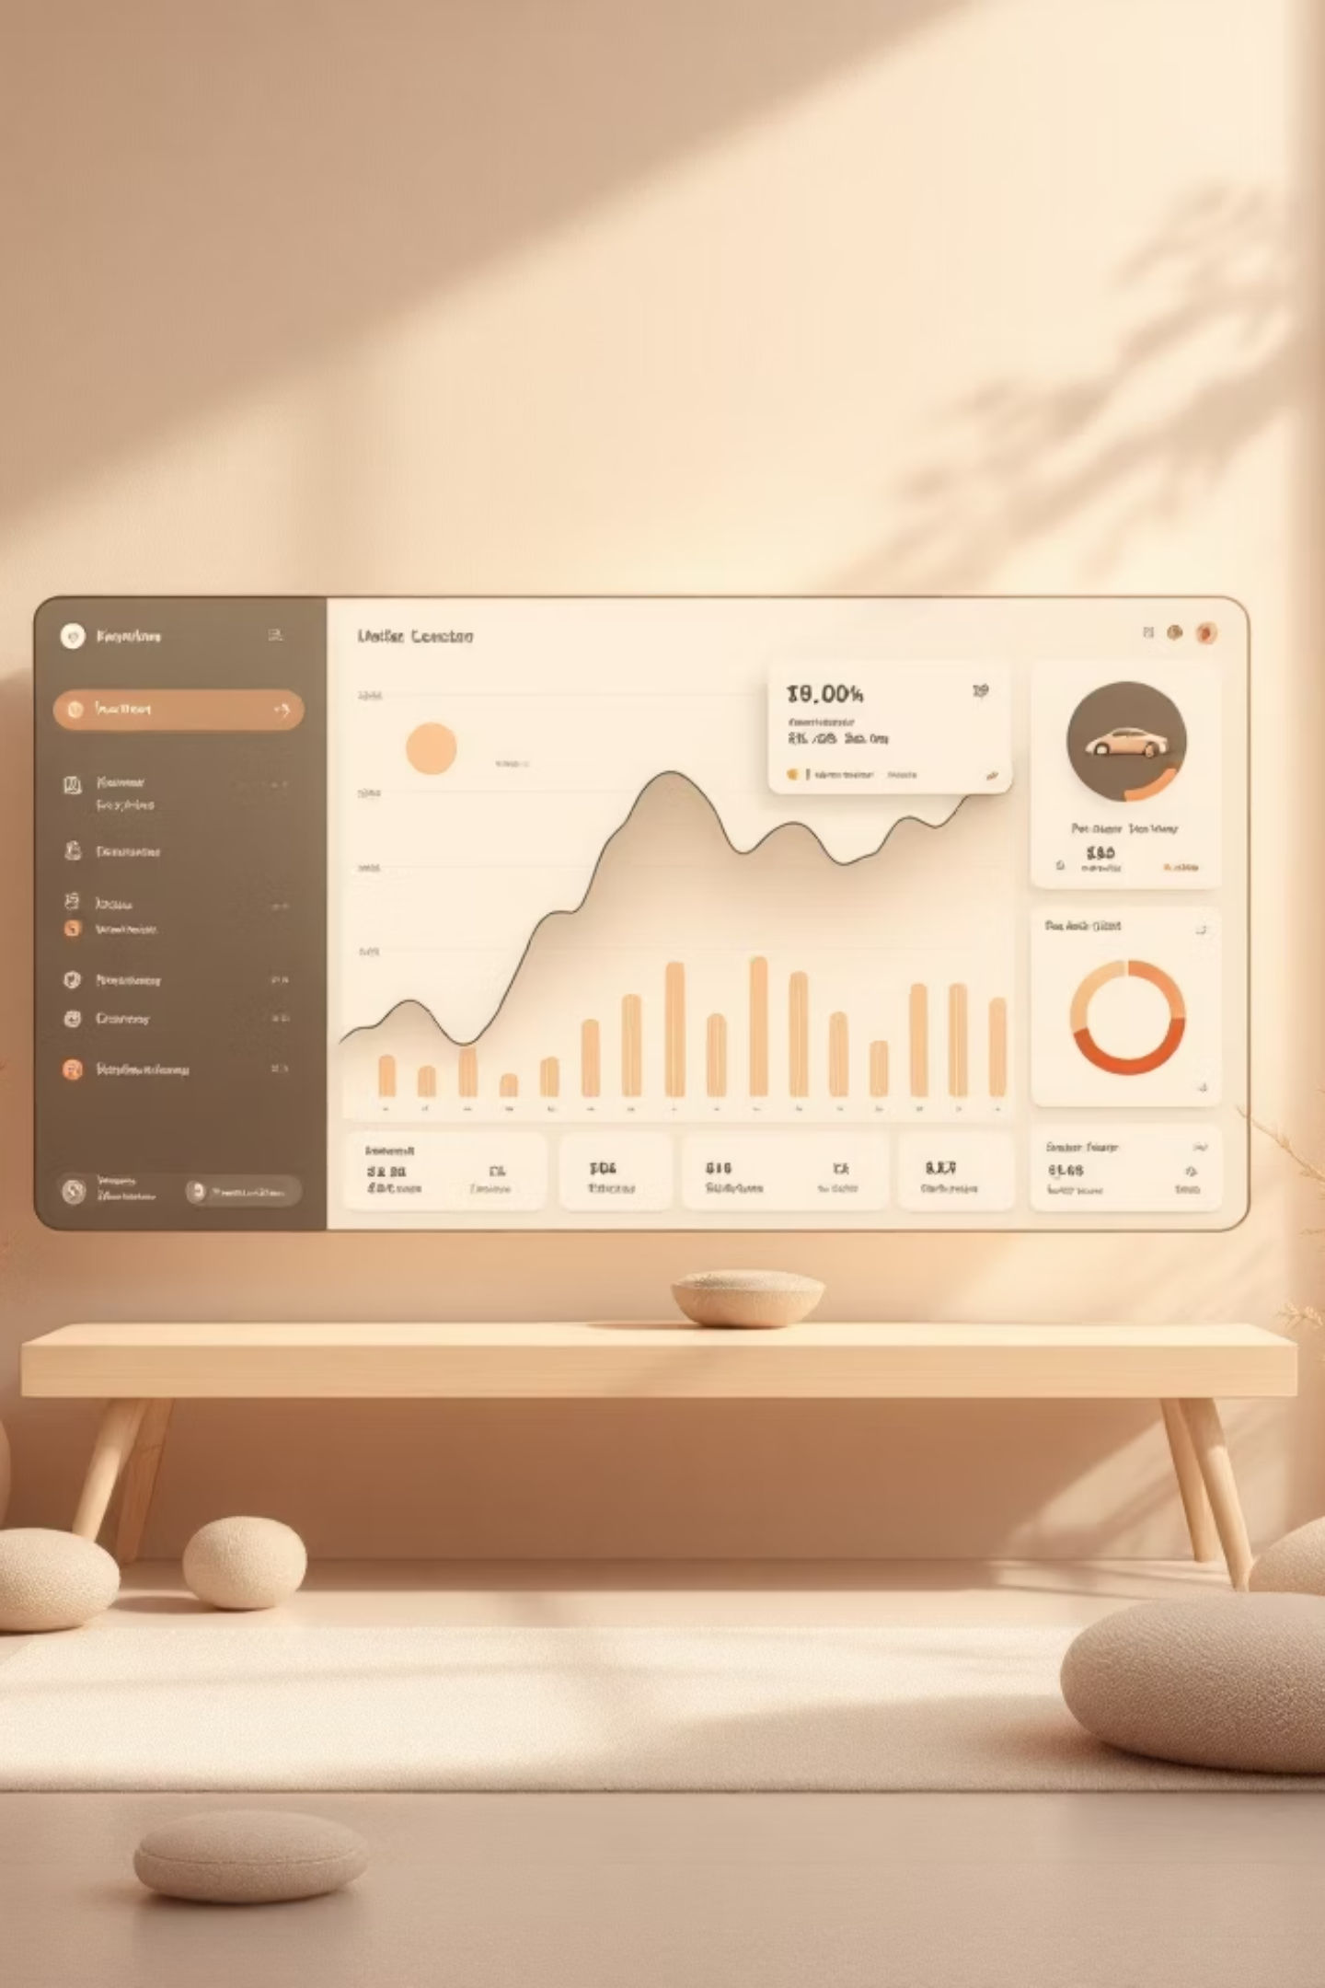
Vehicle Insurance & Claims Management
End-to-end digital platform — from instant quotes to direct bank payouts

Slide 2
Traditional Insurance vs VehicleSure
Traditional Insurance
VehicleSure Platform
Slow manual paperwork processes
Disconnected teams and departments
No real-time application tracking
Manual claim assessment and errors
Delayed payouts via cheque or NEFT
No unified platform for all parties
Instant online quote engine
Role-based portals for all stakeholders
Real-time status tracking and notifications
Automated depreciation-based payout calculation
Direct bank transfers via RazorpayX
Single unified platform for all workflows

Slide 3
Technology Stack
Frontend
Backend
Angular 21 · RxJS · Tailwind CSS
Java 17 · Spring Boot 3.3 · Spring Security (JWT)
Database
Premium Payment
MySQL – relational schema, 11 entities
Razorpay – order creation + HMAC signature verification
Claim Payout
Email
RazorpayX – direct bank transfers to customer accounts
n8n – webhook-triggered transactional emails
PDF Generation
Excel Reports
OpenPDF – invoice and policy documents auto-generated
Apache POI – premium and payout history exports

Slide 4
System Roles
Customer
Underwriter
Request quotes and buy policies
Pay premiums via Razorpay
Submit and track claims
Review assigned applications
Verify RC and invoice documents
Approve or reject with reason
Claims Officer
Admin
Review assigned claims
Calculate depreciation payout
Approve or reject claims
Manage staff and policy plans
Assign applications and claims
Trigger RazorpayX payouts

Slide 5







Workflow 1: Insurance Issuance
Quote → Application → Underwriting → Payment → Policy Activation
Get Quote
Customer enters vehicle details, gets instant premium options
Submit Application
Choose plan, upload RC and invoice documents
Assign Underwriter
Admin assigns to available underwriter based on workload
Review & Decide
Underwriter approves (creates policy) or rejects with reason
Pay Premium
Razorpay checkout, HMAC signature verified server-side
Activate Policy
PDF invoice and policy document generated, policy becomes active
Download Documents
Invoice and policy document available on dashboard

Slide 6
Workflow 2: Claim Settlement
Phase 1: Submission & Assignment
01
02
File Claim
Assign Officer
Customer submits with claim type, bank details, and up to 3 supporting documents
Admin checks officer workload and assigns a Claims Officer
03
04
Review & Calculate
Approve / Reject
Officer assesses documents, computes depreciation payout
Set approved payout amount or reject with reason
Phase 2: Payout & Settlement
01
02
Trigger Payout
Record & Notify
Admin processes RazorpayX bank transfer
ClaimsPayment record saved; status changes to SETTLED
03
04
Receive Transfer
Policy Update
Amount credited to customer's bank account directly
Total-loss claims set policy to INACTIVE

Slide 7
Key Features
Smart Quote Engine — IDV and risk scoring in real time
Role-Based Dashboards — Separate portals per stakeholder
Document Upload — RC and invoice upload with verification
Razorpay Integration — Secure order and HMAC signature flow
Auto PDF Generation — Invoice and policy documents on payment
Multi-Type Policies — Third Party, Comprehensive, Zero Dep
Claims Filing Portal — Self-service with 3-document support
RazorpayX Payouts — Direct bank transfer on approval
In-App Notifications — Real-time alerts at every step
Excel Report Export — Admin exports for audit trail

Slide 8

Business Rules & Calculations
IDV Calculation
Premium Calculation
Claim Payout Logic
Formula: IDV = Ex-Showroom Price × (1 − Age × 10%)
Formula: Base Premium × Risk Multiplier × IDV Multiplier
THEFT → Payout = Full IDV; Policy closed
Maximum depreciation capped at 50%
LOW risk (score ≤1) → 1.0× | No increase
DAMAGE > 75% IDV → Total Loss; Payout = Full IDV
Example: 3-year car ₹8L → ₹8L × 0.70 = ₹5.6L
MEDIUM risk (score 2) → 1.2× | +20%
DAMAGE ≤ 75% IDV → Comprehensive: Depreciated Bill | Zero-Dep: Full Bill (no depreciation)
Example: 6-year car ₹5L → ₹5L × 0.50 = ₹2.5L (cap applies)
HIGH risk (score ≥3) → 1.5× | +50%
Multi-year: 2 years = ×1.9 (5% off) | 3 years = ×2.8 (7% off)
THIRD PARTY → Payout = min(Bill, Max Coverage Amount)
Final Payout = Calculated Amount − Deductible (minimum ₹0)

Slide 9
Integrations & Security
Razorpay — Premium Collection
RazorpayX — Claim Bank Payouts
n8n Webhook — Email Automation
Customer pays policy premium online
Backend creates Razorpay order in paise
HMAC-SHA256 signature verified server-side
Policy PDF and invoice auto-generated on success
Approved claim triggers bank payout
Contact and Fund Account created via API
Bank transfer processed directly to customer
Mock mode available for test environments
Staff creation triggers welcome email
Credentials sent via n8n webhook payload
Email failure does not block staff creation
Fully decoupled from backend transaction
Security Measures
JWT Authentication
Spring RBAC
Bearer token required on every API request
@PreAuthorize annotation on every controller
BCrypt Hashing
Input Validation
Passwords never stored in plain text
Regex validation for VIN format and registration number

